Slide 1
TEMPORAL DOMINANCE SENSATION
During data collection, the trained panel work independently and continuously over time, selecting the attribute that is dominant from a list of approximately 10 attributes and rating that attribute’s perceived intensity.

Slide 2
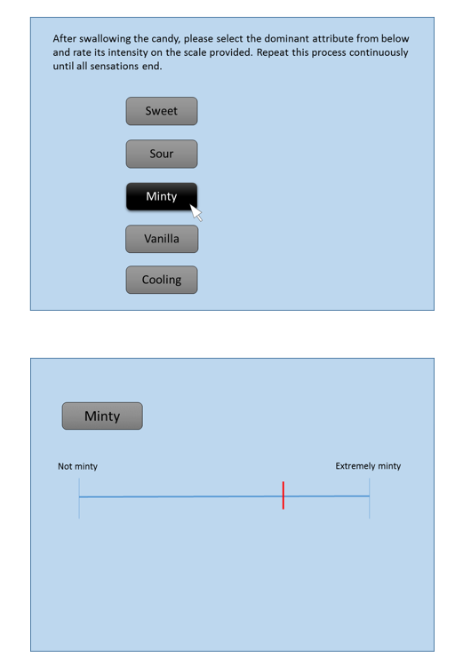
https://deakincass.wordpress.com/2014/02/18/introducing-temporal-dominance-of-sensation/

Slide 3
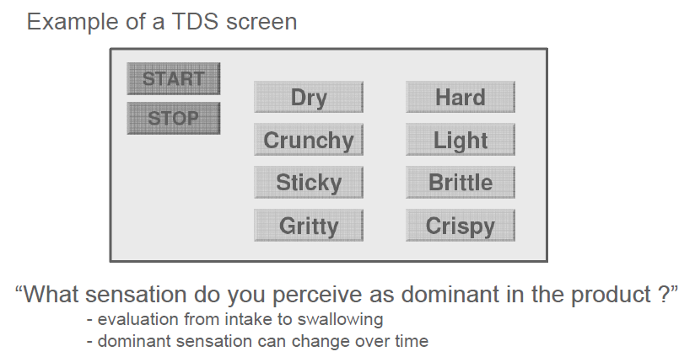
Pineau et al (2010)
Nestle Research

Slide 4
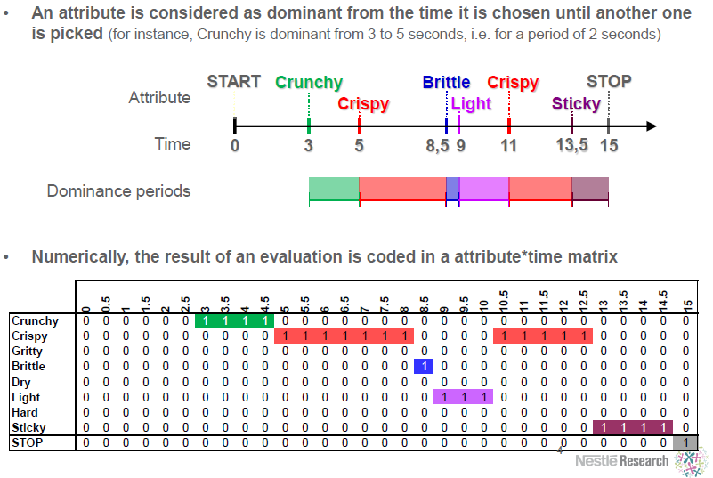
Pineau et al (2010)
Nestle Research

